Slide 1


Exploratory Data Analysis- Lending Club Case Study
Group Members:
1 - Subhrajit Pyne
2 - Utkarsh Srivastava

Slide 2
Overview
Company
Context
Problem statement
Lending Club is the largest online loan marketplace, facilitating personal loans, business loans, and financing of medical procedures.
Borrowers can easily access lower interest rate loans through a fast online interface.
Lending Club wants to understand the driving factors behind loan default,
i.e. the driver variables
which are strong indicators of default.
The company can utilise this knowledge for its portfolio and risk assessment.
Identify patterns how consumer attributes and loan attributes influence the tendency of default, which may be used for taking actions such as denying the loan, reducing the amount of loan, lending (too risky applicants) at a higher interest rate, etc.

Slide 3
Analysis Approach
Data Analysis
Data Understanding
Data Cleaning
Univariate Analysis
Segmented Univariate Analysis
Bivariate Analysis
Recommendations
Explore the Dictionary file to understand the columns in the loan csv and its significance
Drop columns with null values, all random values or single category value
Convert values to proper int, float, date representations
Check distributions and frequencies of various numerical and categorical variables
Create derived variables
Analyse variables against segments of other variables
Create derived variables
Do correlation analysis Check how two variables affect each other or a third variable
Analyse joint distributions
Analysing all plots and recommendations for reducing the loss of business by detecting columns best which contribute to loan defaulters.

Slide 4
Variable Types
Consumer – (Annual income, Employee Length, Employee Title)
Loan information & characteristics - (Loan Amount, Loan Status, Loan Grade/ Sub Grade, Amount investment, Interest rate)
Customer behavior – (delinquency year-2, earliest, purpose, recoveries, earliest cred line, application type, revolving balance)

Slide 5
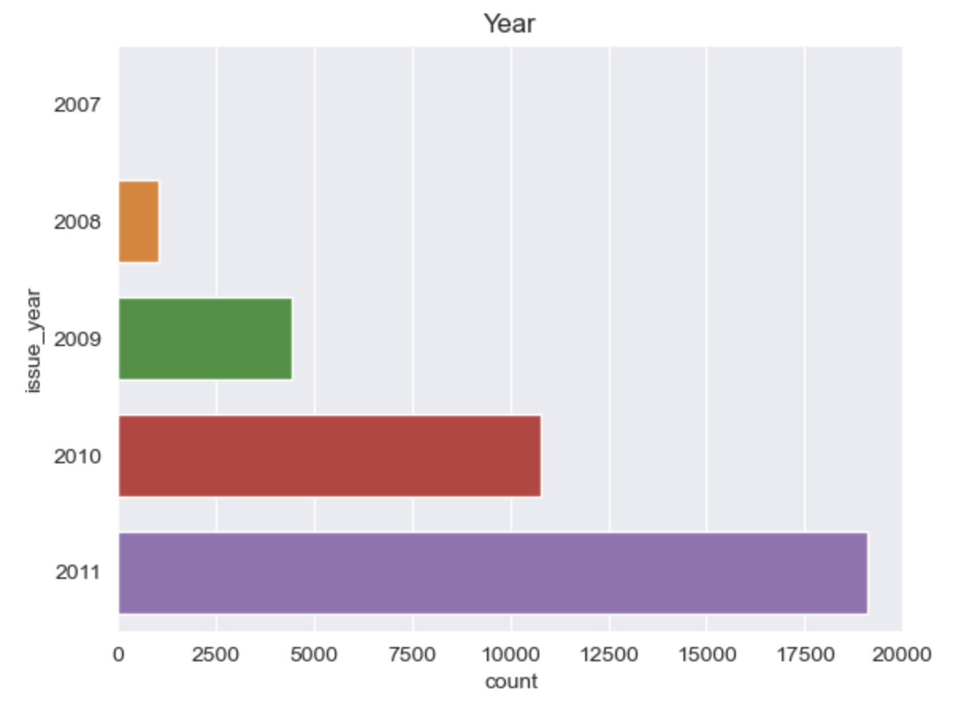
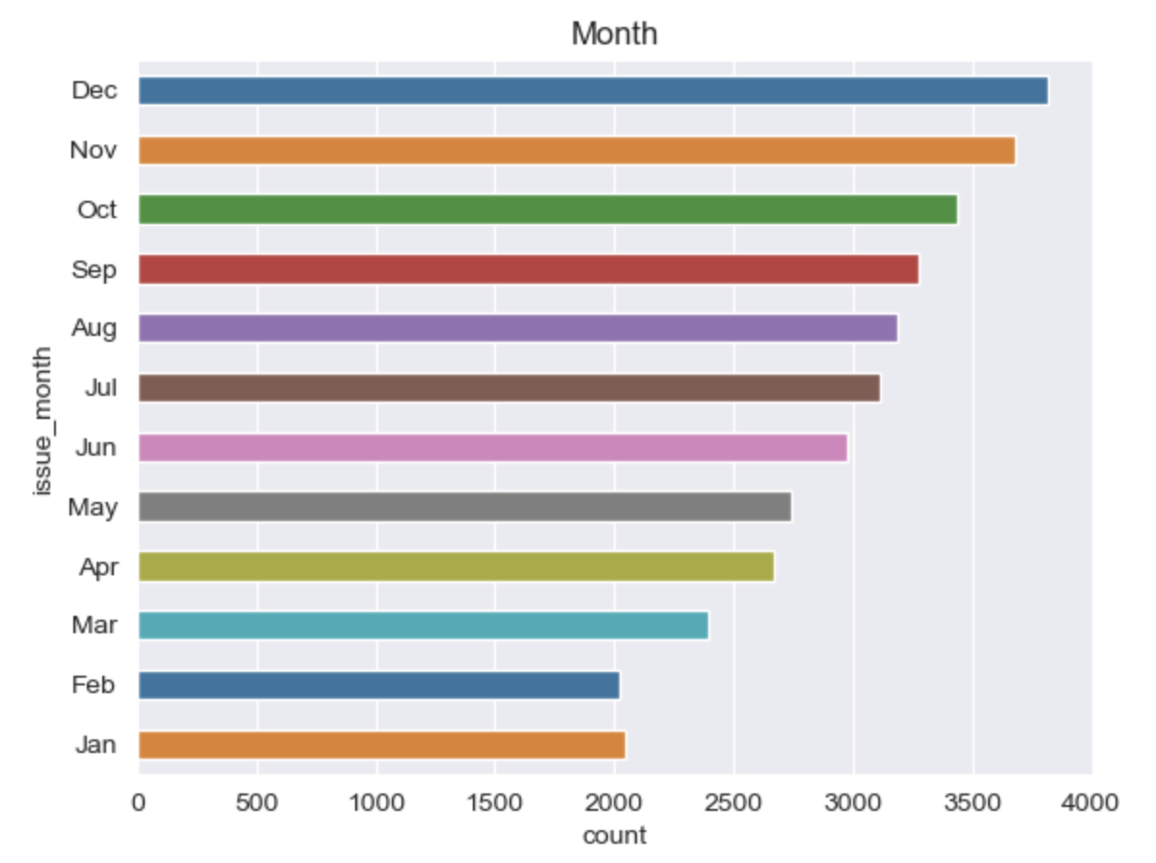
Analysis
Loan Issue Year: Loan issuing has increasing year by year, the number of loan issued has doubled every year. In 2011, number of applicants are more
Loan Issue Month: Loan issuing month is increasing from January to December. In last quarter, most loans has been issued. This could be because of new year resolution.

Slide 6
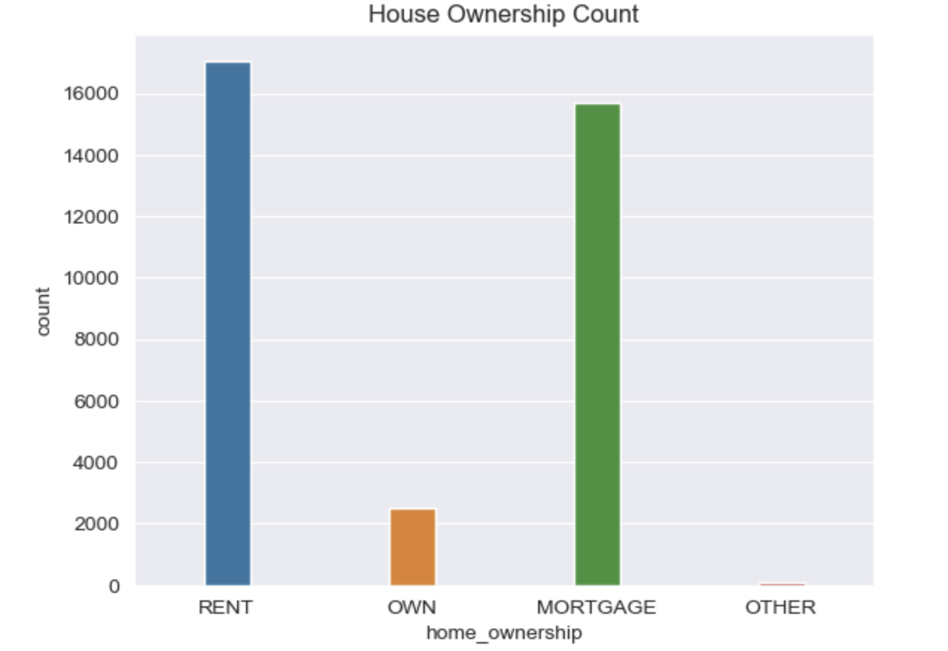
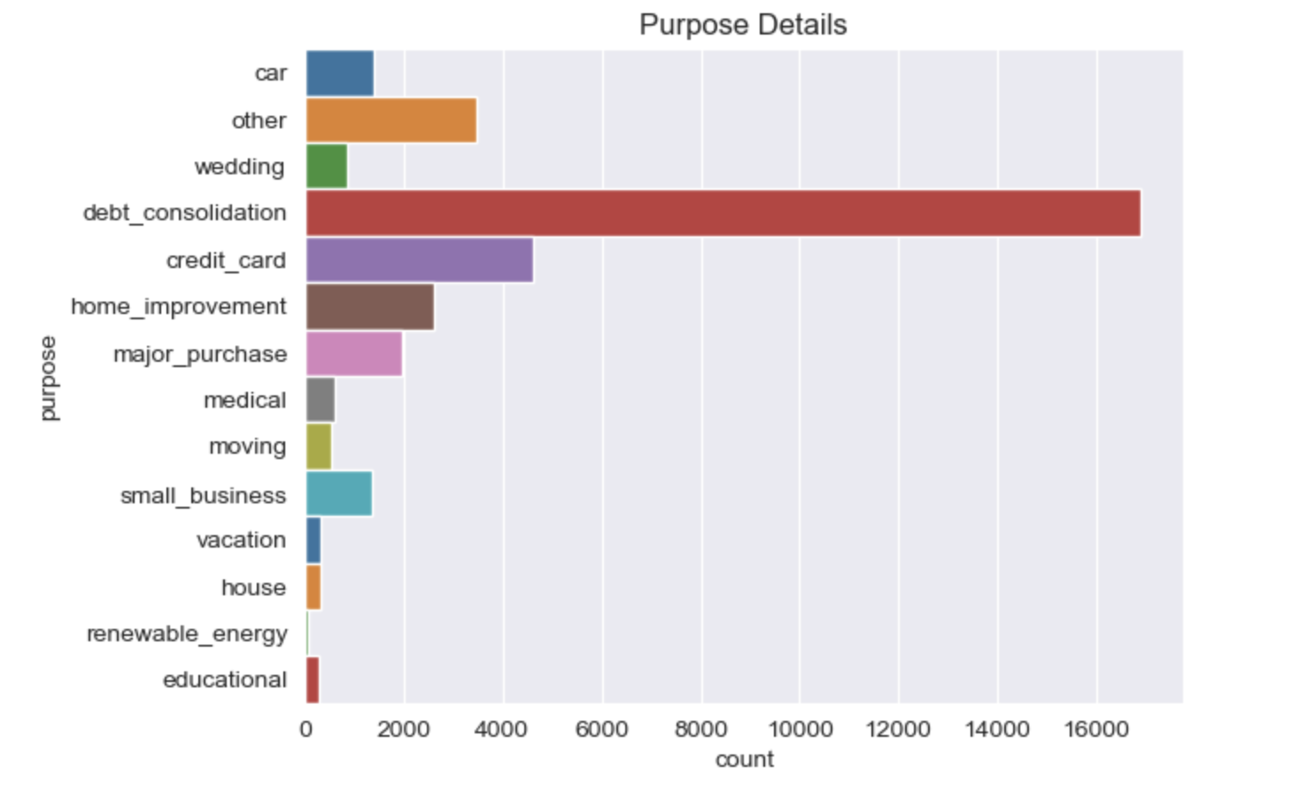
Analysis
Purpose: Most loan are taken for debt consolidation, credit card and others.
House Ownership: Most loan applicants live in rented house or house which is already under mortgage. These applicants have higher chance of defaulting

Slide 7
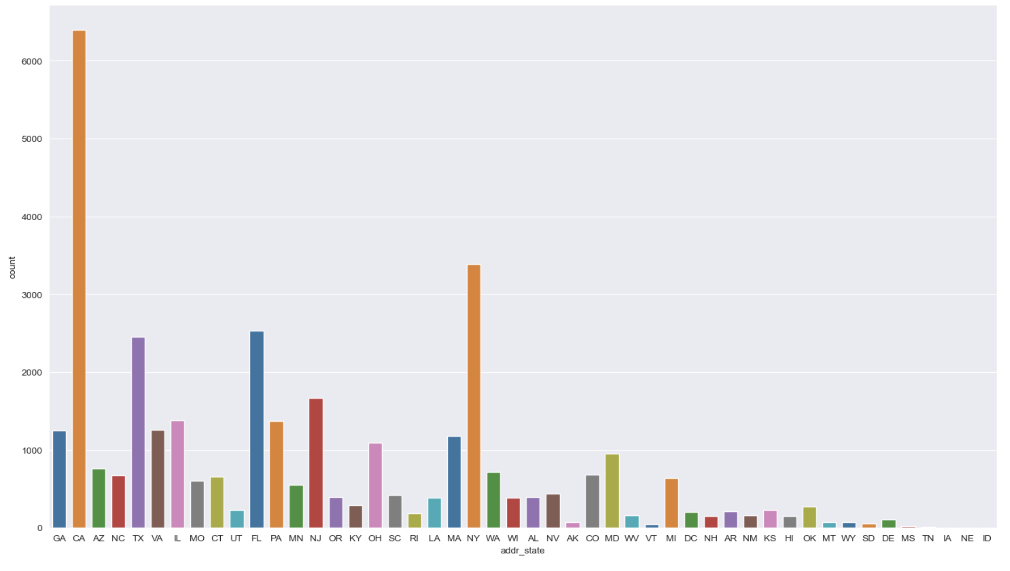
Analysis
State Address: For cities like CA, NY,FL and TX state has the greatest number of loan applicants so chances of getting defaulted is more than other states.

Slide 8
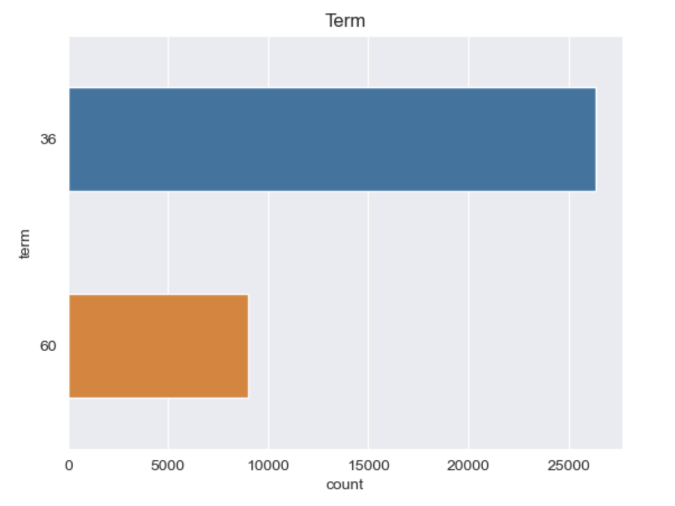
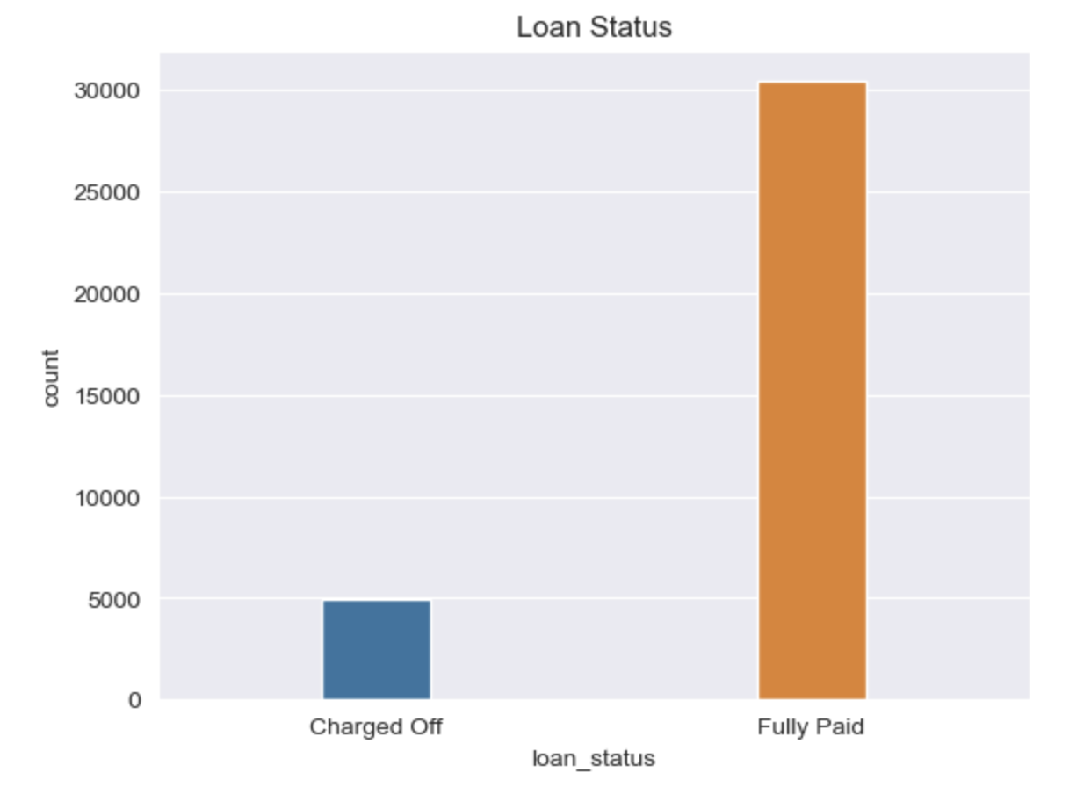
Analysis
Loan Term: There are only two loan terms 36 and 60 months. Most of the borrowers applied for 36 months term
Loan Status: Fully paid borrowers are around 85% and charged off borrowers are around 15%

Slide 9
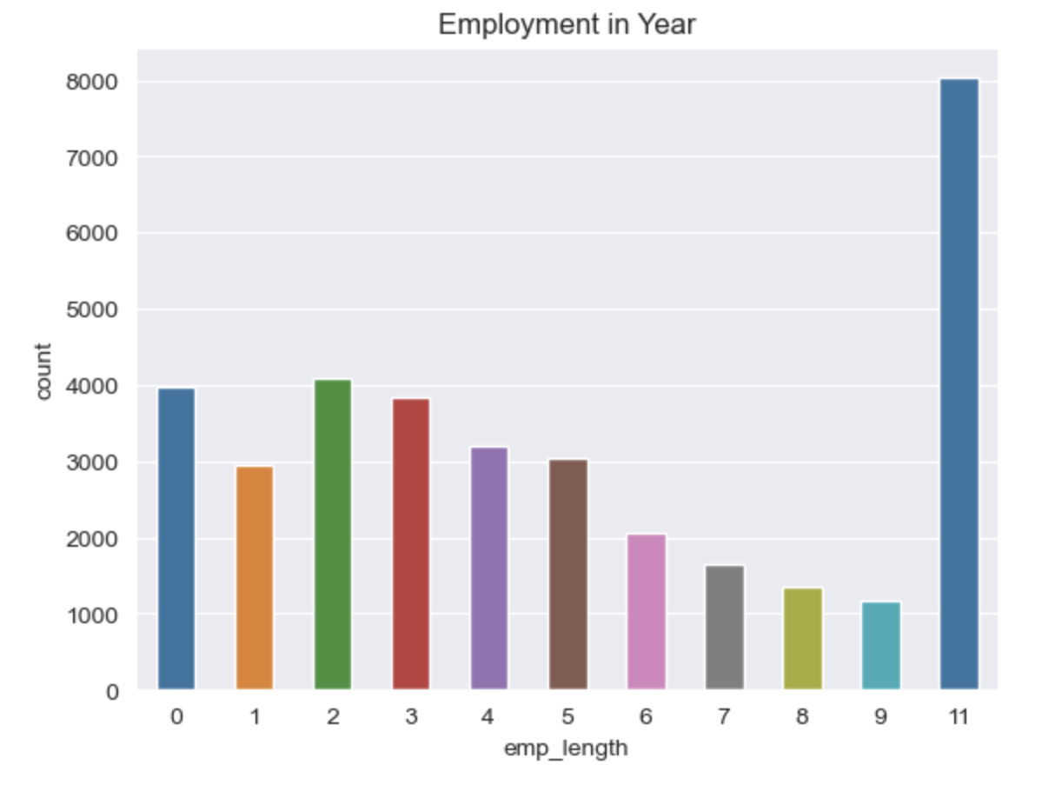
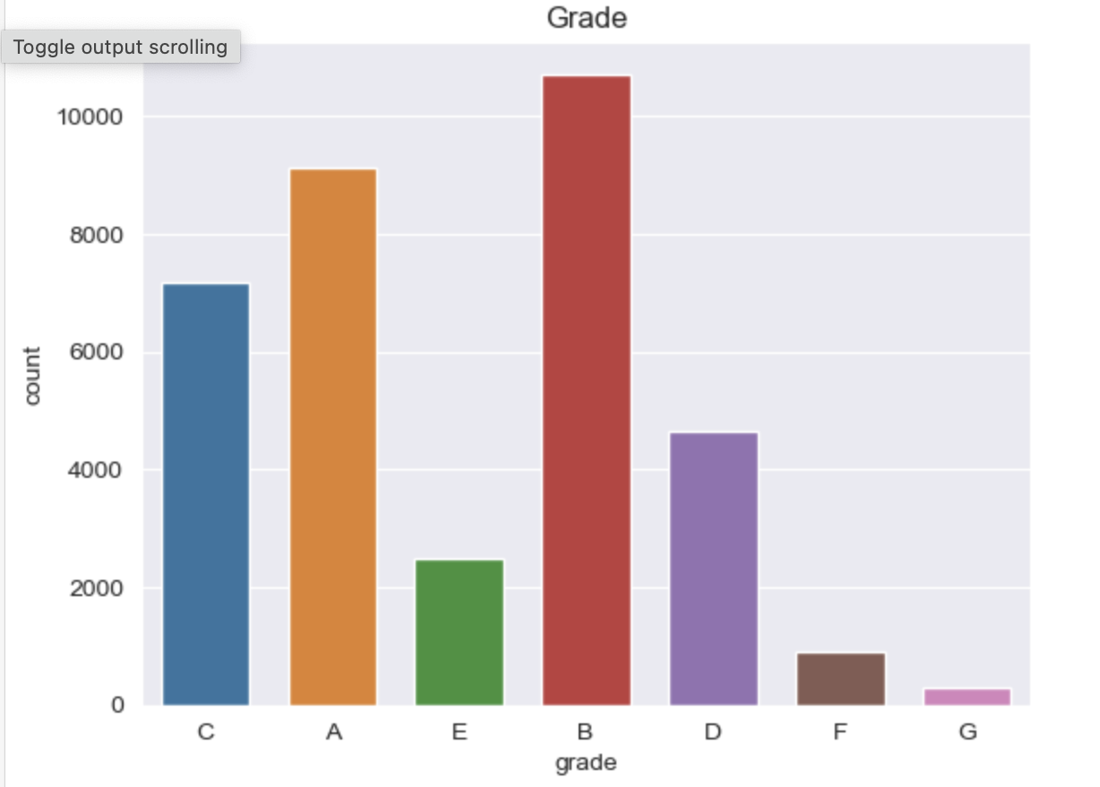
Analysis
Employment Length: Majority of borrowers have 10+ years of experience and has highest number of defaulted loan.
Loan Grade: Majority of borrowers are from grade B.

Slide 10
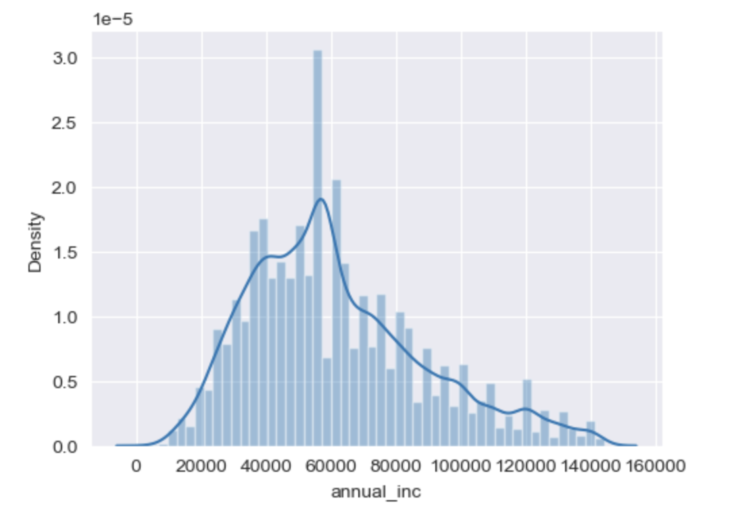
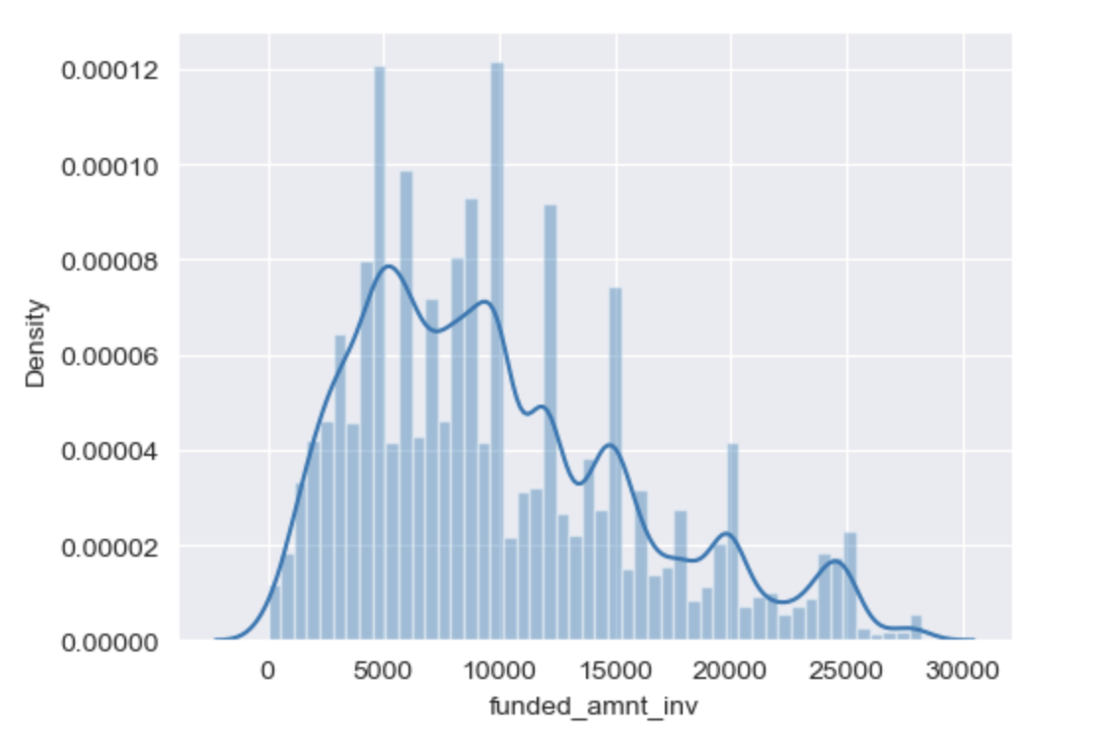
Analysis
Annual Income : Majority borrowers have low annual income compared to rest and income lower than 57k has higher chance of defaulting.
Approved Loan: Approved loan amounts are varring between 5k to 14k (Q1 and Q3)

Slide 11
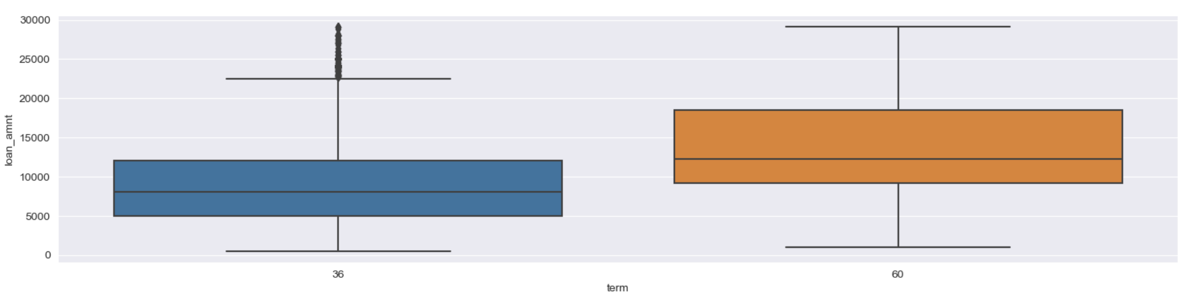
Bivariate Analysis
Loan Amount :-
36 Month tenure has more fully paid customers and has a greater number of defaulters but when we go by ratio,
60 month has more defaulter than 36 months tenure
Analysis:- Thus, most of the 60 months tenure choosers having more chance to default

Slide 12
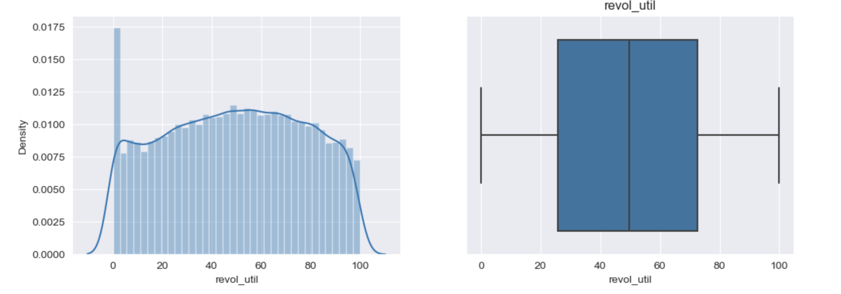
Bivariate Analysis
Outcome- Maximum loan applicants are between 25 to 72.

Slide 13
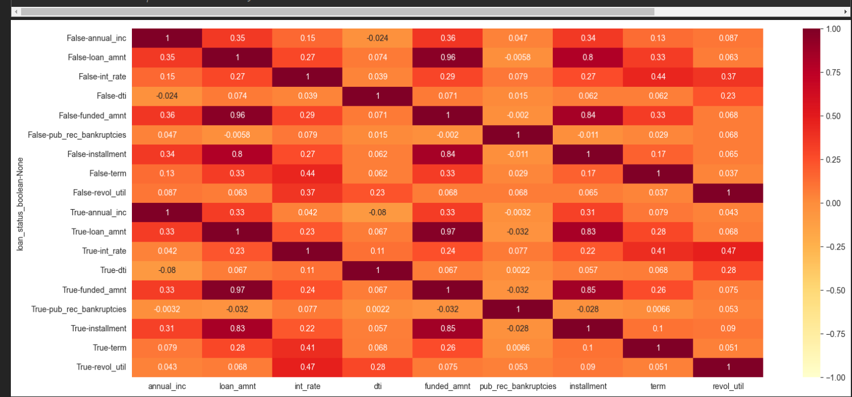
Bivariate Analysis
Outcome: More-darker the point with False, more the risk

Slide 14
Final Summary
Upon analysing on all the points, We have derived some points which Lending Club can follow to minimize bad loans:
Giving loan to the applicants having annual income higher than 40K and low interest rate (below 15%) may minimize the bad loan.
Smaller term (36 months) can minimize the bad loans.
Loan grading has a significant impact on loans.
Loan can be provided who has own house.
Purpose like small business and another loan repayment has most numbers of defaulters.
Public bankruptcy record must be 0 or 1. Higher the record value, higher the risk of bad loan.
Address Cities has lower impact on loan status as well.
High dti(15+) leads to more bad loans thus loan funding should be made on annual income.
Month and year has lower impact.
Credit Utilization Ratio (revol_util) has a big significance. High utilization leads to bad loan. Thus, Lending Club should provide loans to lower utilization rate applicants.

